Slide 1
Metacharacter Filtering
Prepared by:
Chirag Ganguli [ 19BCY10158 ]

Slide 2

Introduction:
For any type of data, a program also maintains metadata that it tracks
Metadata is the information that describes the main data
It might include how to format the data for display, processing instructions, or information on how pieces of data are stored in the memory

Slide 3
In-band vs. Out-of-band Representation:
In-band representation embeds the metadata in the data itself. While embedding metadata in textual data, it is indicated by special characters called meta characters. Eg: NULL character terminator in a C string
Out-of-band representation keeps metadata separate from data & associates the two. Eg: Many programming languages don’t have a string terminator character; instead they store the string’s length in an out-of-bounds variable

Slide 4
What is Metacharacter filtering ?
The potential issues associated with meta characters requires a more defensive code strategy that involves attempting to detect potential attacks / sanitise input before it’s interpreted.
Options Include:
Detect erroneous input & reject what appears to be an attack
Detect & strip dangerous characters
Detect & encode dangerous characters with a metacharacter escape sequence
Multiple encoding in web data

Slide 5
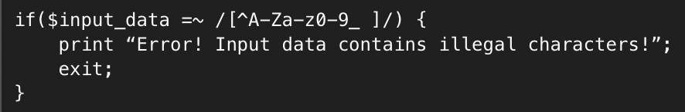
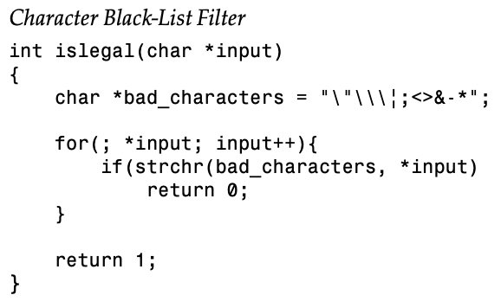
1.0 Eliminating Meta characters
If the disallowed input is rejected, any request containing illegal meta characters is simply discarded
This usually includes some sort of error indicating why the input wasn’t allowed
In the eg, the input_data variable is checked for any character that isn’t alphanumeric, an underscore or a space. If any of them are found, the processing terminates

Slide 6

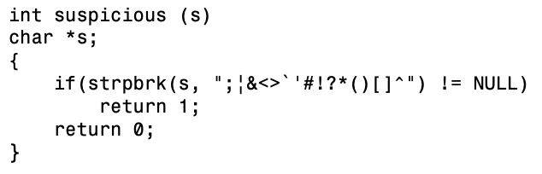
2.0 Insufficient Filtering
Metacharacter Vulnerability
Filter is constructed to strip out dangerous characters before the data is passed to popen().
People think about other commands separators such as semicolons, but often neglect to filter out the newline character
Sanitizing input for a call to popen(), one needs to be aware that any data passed to the program being called is interpreted by the command shell and then by the program

Slide 7
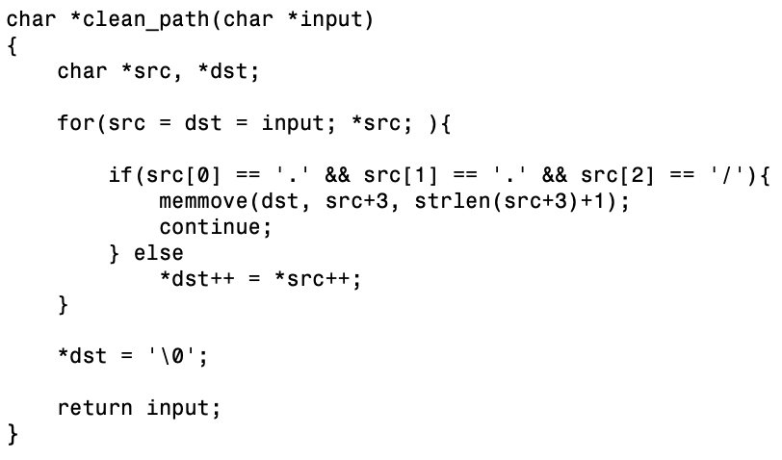
3.0 Character Stripping Vulnerabilities
The algorithm alongside removes ../ sequences
What happens for ….//hi ?
This demonstrates a subtle issue. By supplying characters around forbidden patterns that combine to make the forbidden pattern, one needs to filter itself to construct the malicious input by stripping out the bytes in between

Slide 8
4.0 Escaping Metacharacters
It doesn’t deny / remove metacharacters but handles them safely. Most common method is to perpend an escape metacharacter to any potentially dangerous metacharacters thus allowing these characters to be safely interpreted as a 2-character escape sequence (applications won’t interpret the metacharacter directly)

Slide 9
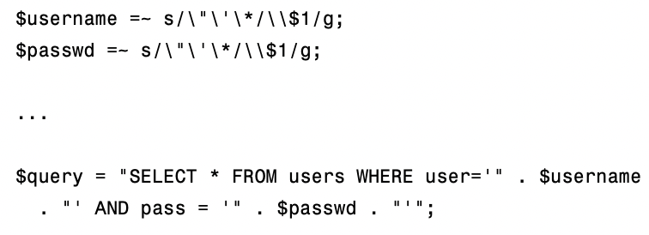
4.1 Escaping Metacharacters
This query replaces dangerous quote characters with an escaped version of the character
Eg: Username of “chirag’ or user <> ‘chirag” would be replaced with “chirag\’ OR user <> \’chirag”.
So the attackers couldn’t break out of the single quotes & compromise the application
Attacker Perspective:
username = chirag\’ OR username =
Passed = OR 1=1
-> SELECT * FROM users WHERE user=‘chirag\\’ OR username = ‘ AND pass = ‘ OR 1=1

Slide 10
5.0 Metacharacter Evasion
Basic Procedure:
Identify each location in the code where escaped input is decoded
Identify associated security decisions based on that input
If decoding occurs after the decision is made, there’s a problem
Hexadecimal Encoding
HTML & XML Encoding
Multiple Encoding Layers

Slide 11
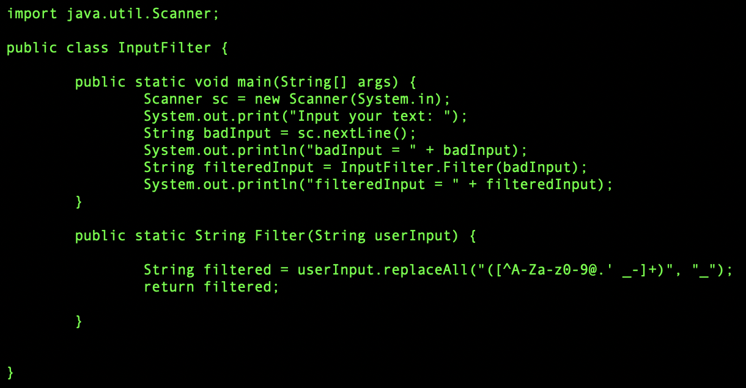
S.01 Sample Code to demonstrate Metacharacter Filtering

Slide 12
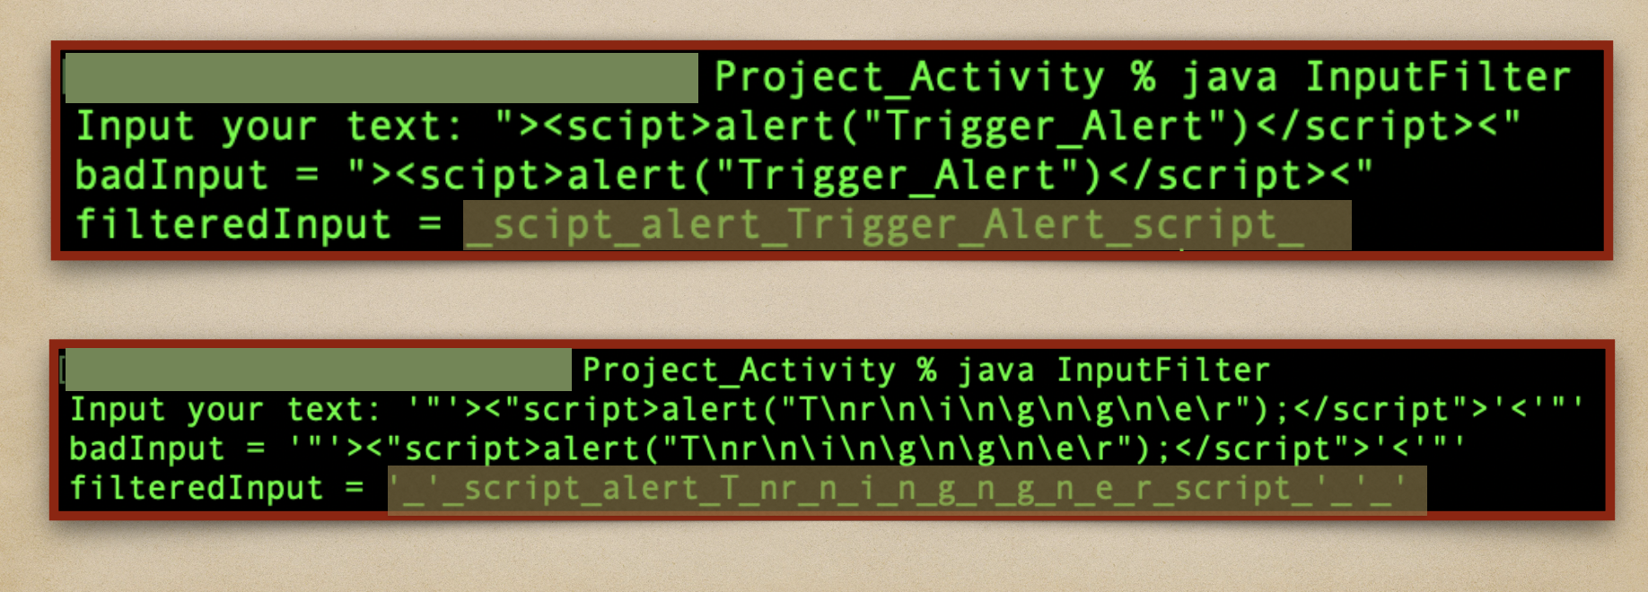
S.02 Filtering Process for the Above Code

Slide 13
S.03 Demo of an attack environment with unfiltered user input
Here, I have created an application that doesn’t sanitize the user inputs / the meta characters are not filtered.
This leads to the website being vulnerable to several attack vectors.
I have attached the XSS demonstration where it displays an unwanted alert on receiving attacker payload (user input).
NOTE: This demo includes a basic frontend application where the attacks are implemented in the client side browser only with minimum impact (due to no involvement of a backend server to execute the user inputs internally).

Slide 14
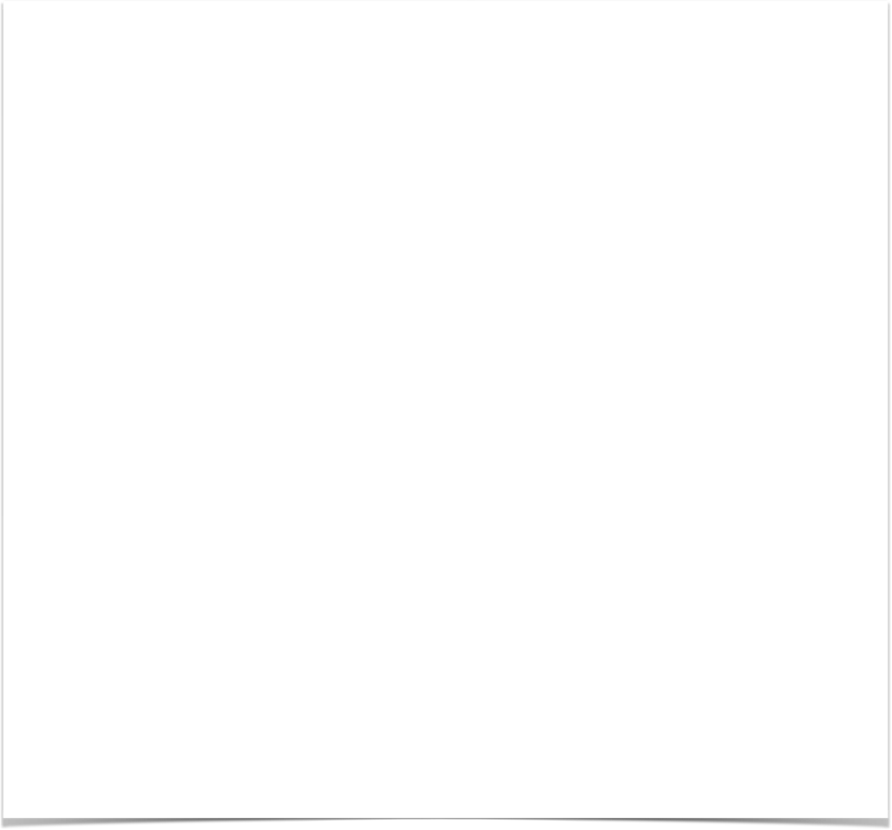
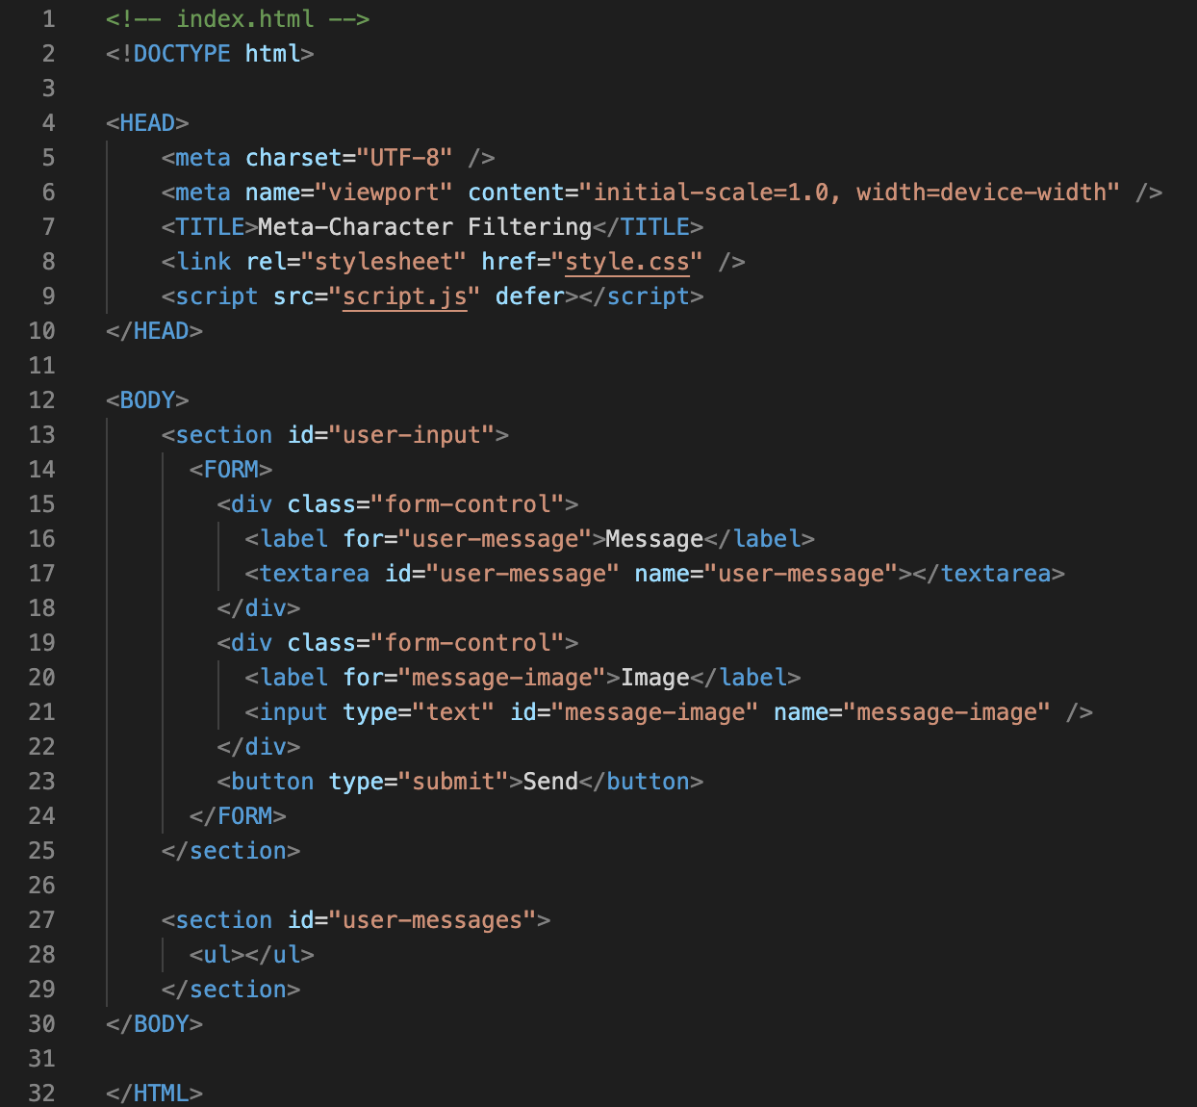

index.html
This includes the code for the frontend part of the website which is viewed by the user.
It includes a user input section where users can enter their input (message + image) & sends it to the server to be posted in the application

Slide 15



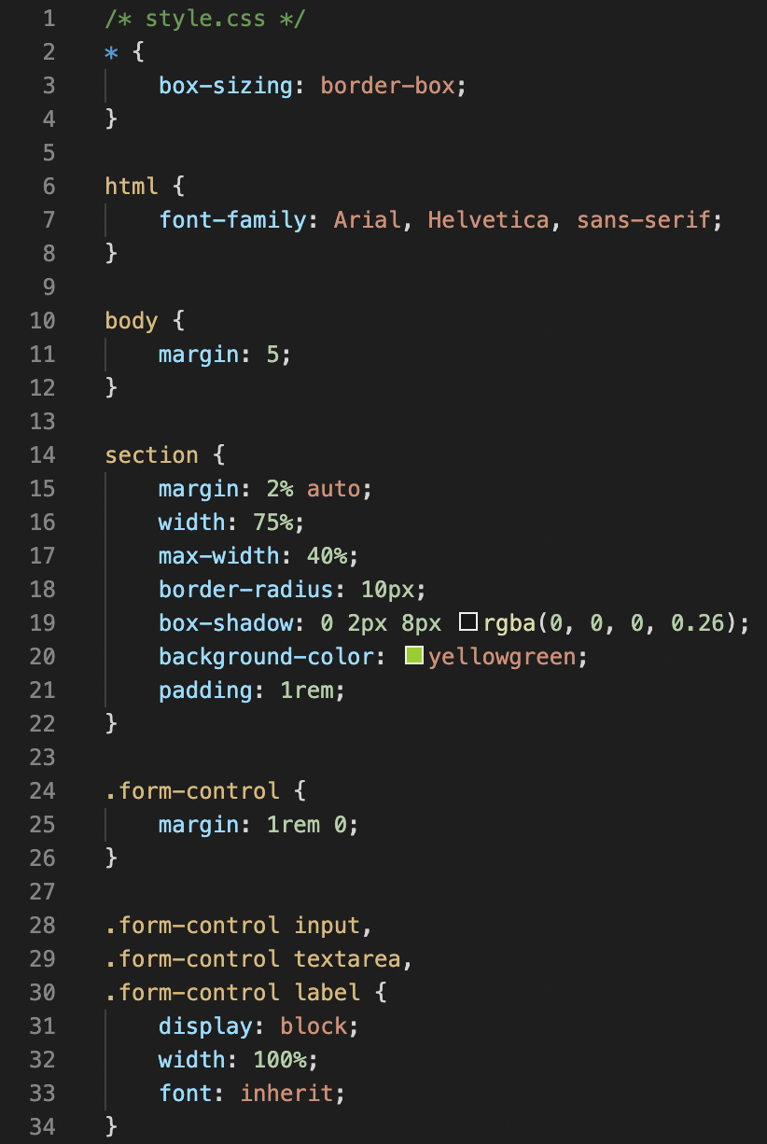
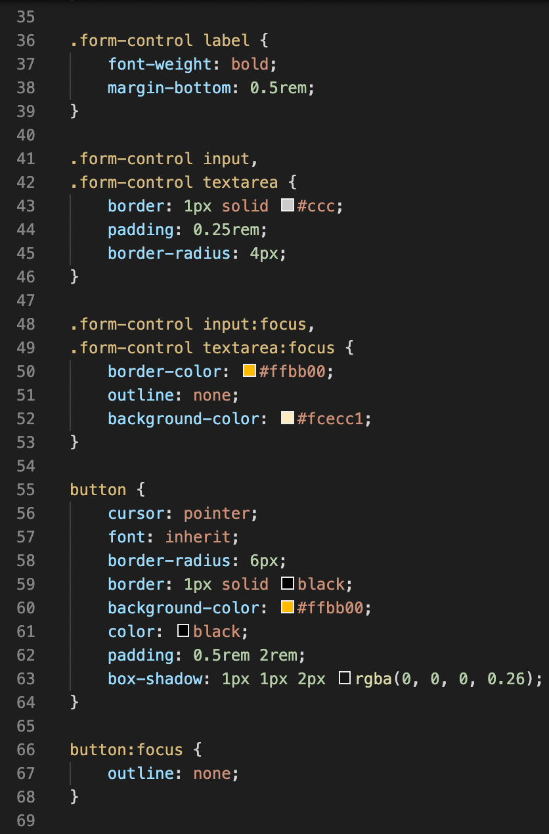
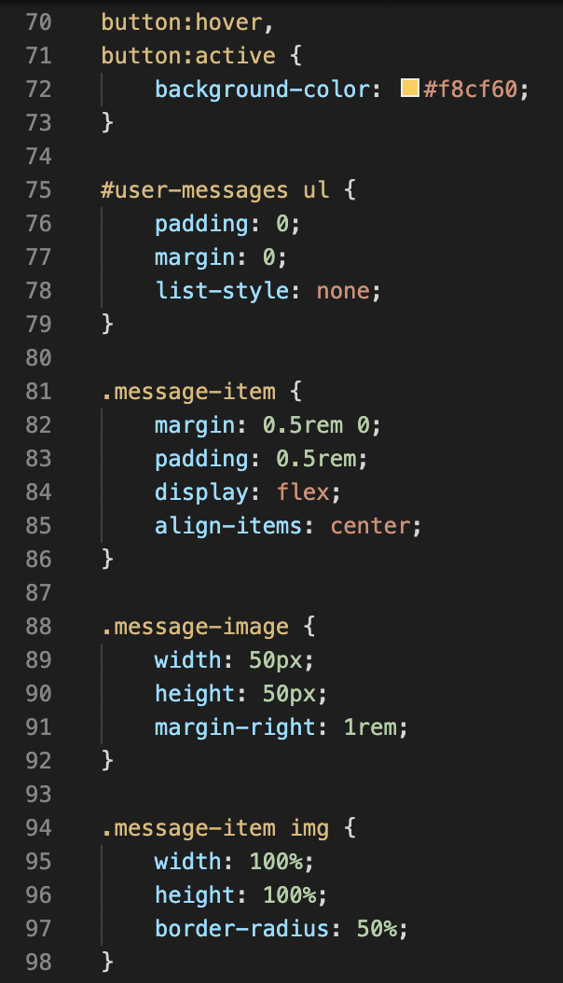
style.css [ Why not add some styles to the page?! ]

Slide 16

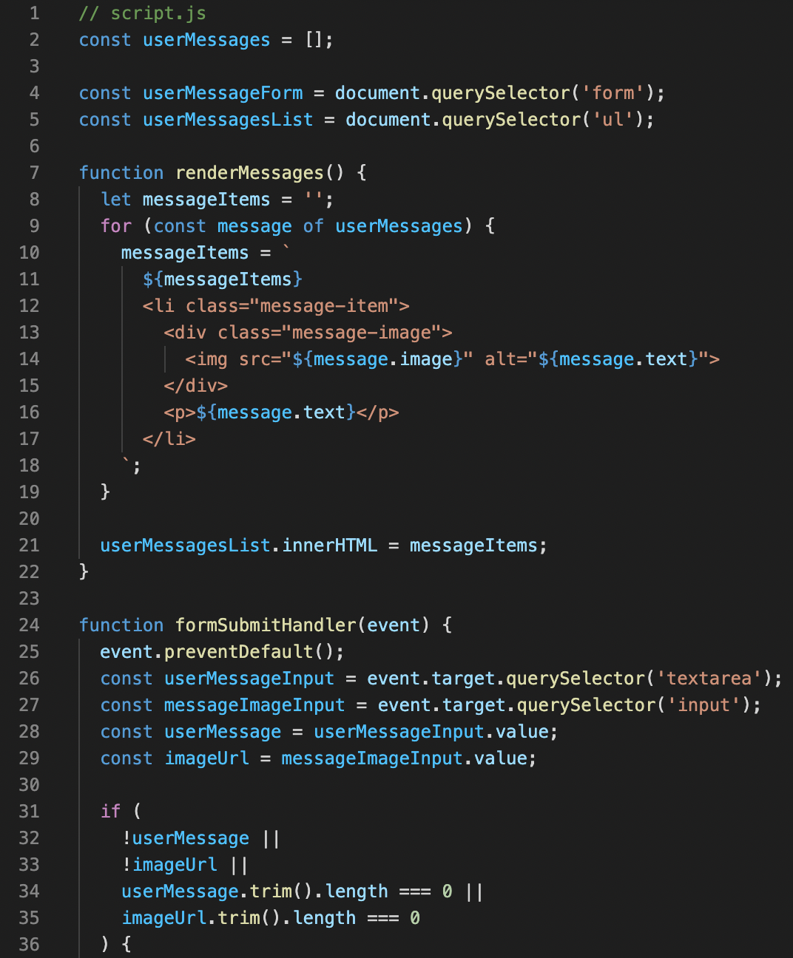
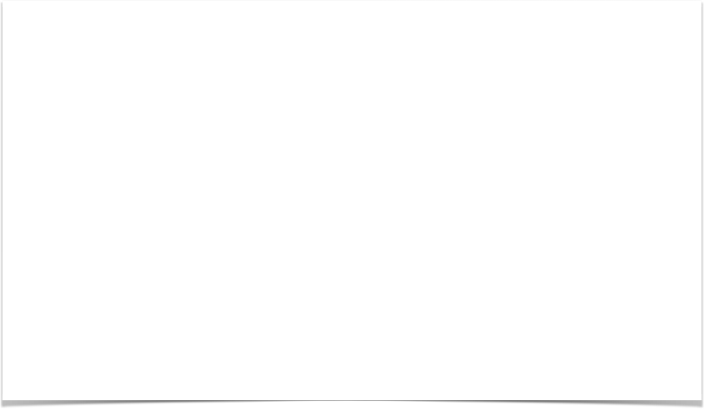
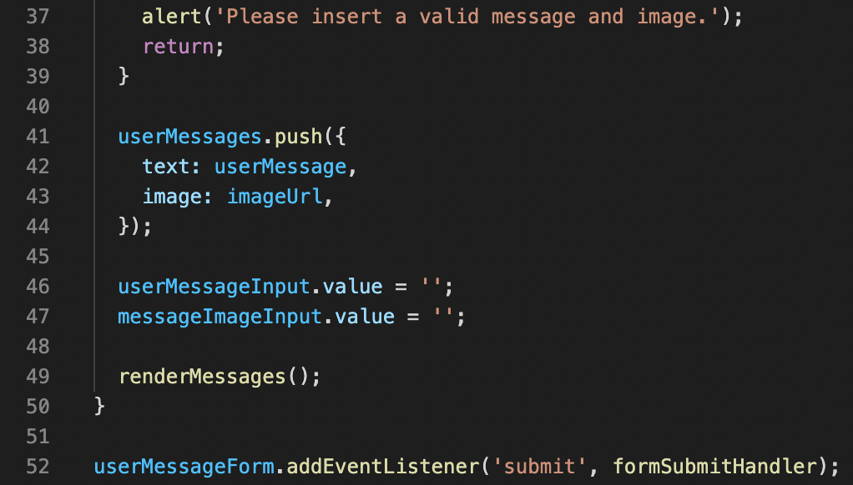
Here comes the most important part of the code script.js

Slide 17
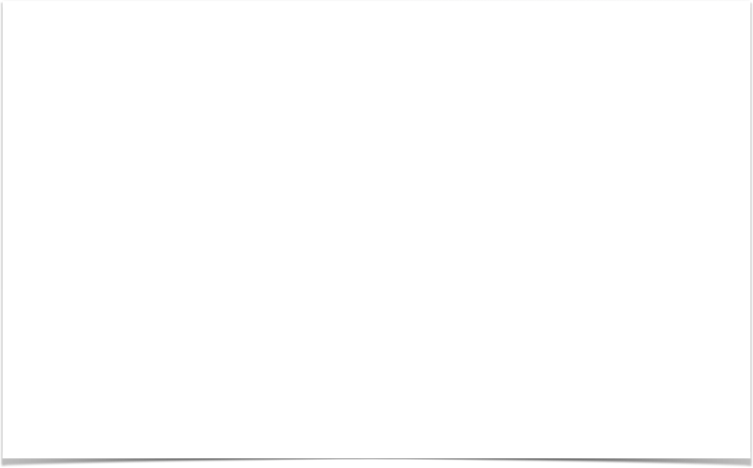
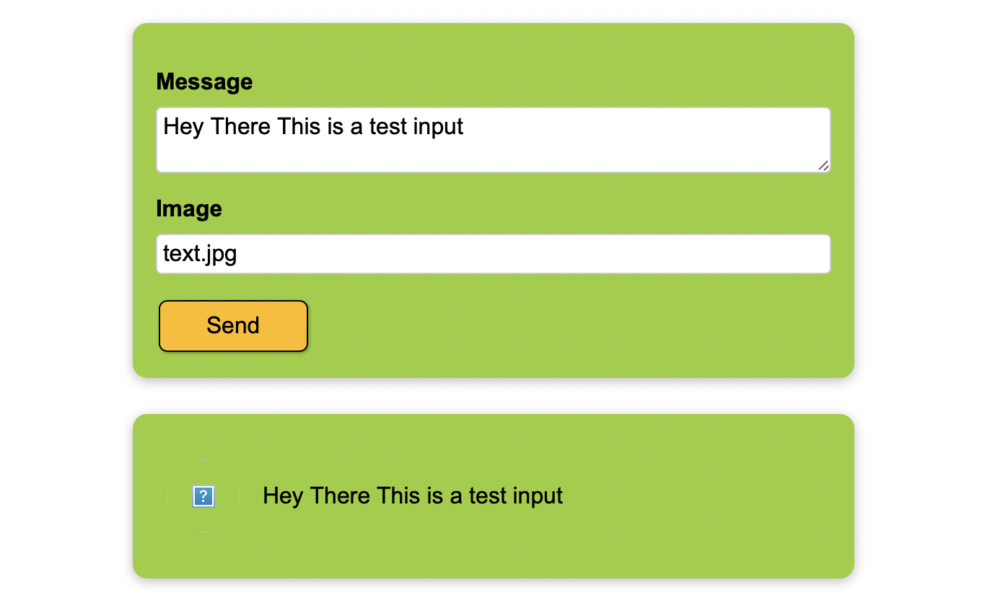

Here’s how the code reacts to usual input
The user here inputs a random message and adds an image file which gets posted as a comment (as shown below) on clicking the send button

Slide 18
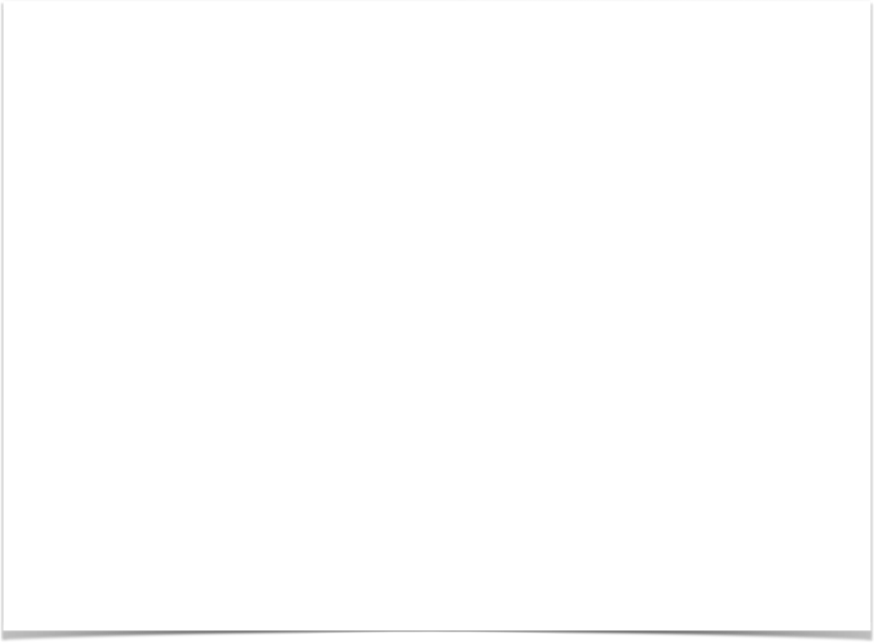
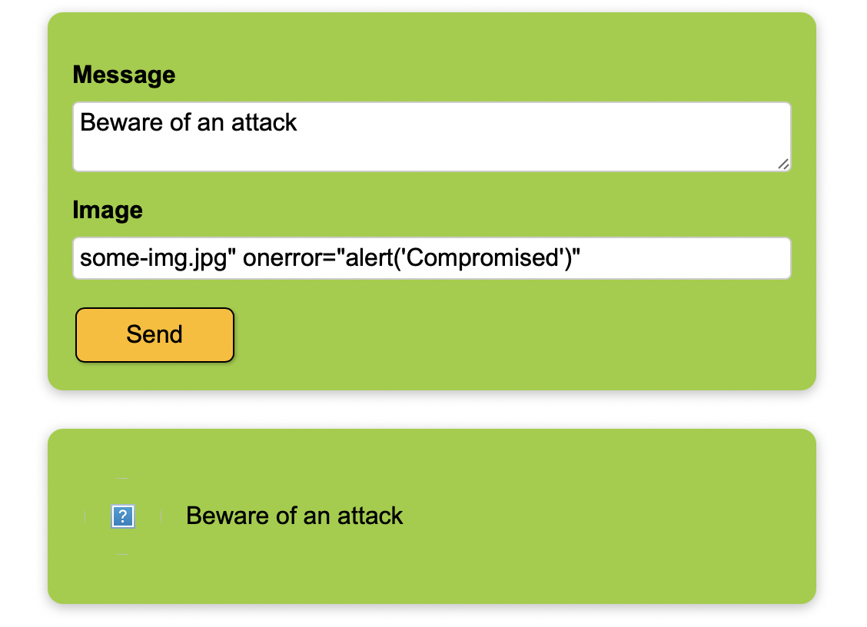

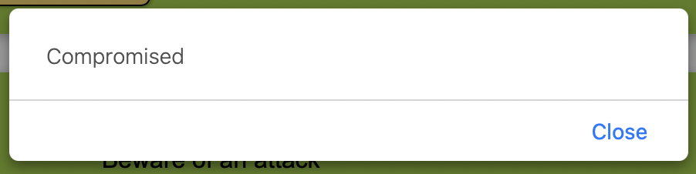

What would happen if an attacker uses this website?
Above image shows the XSS alert triggered because of the user input which is not filtered

Slide 19
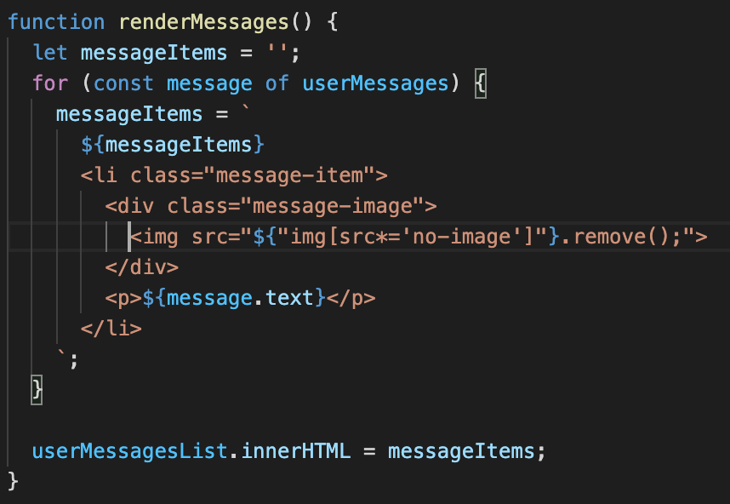

How can we stop this kind of attack ?
Here, I have altered the renderMessages() function a bit, in order to filter the user input to prevent any unwanted characters from the image user input field.
Note: This is a JS utility that prevents this sort of attacks at an initial state with low impact user inputs

Slide 20
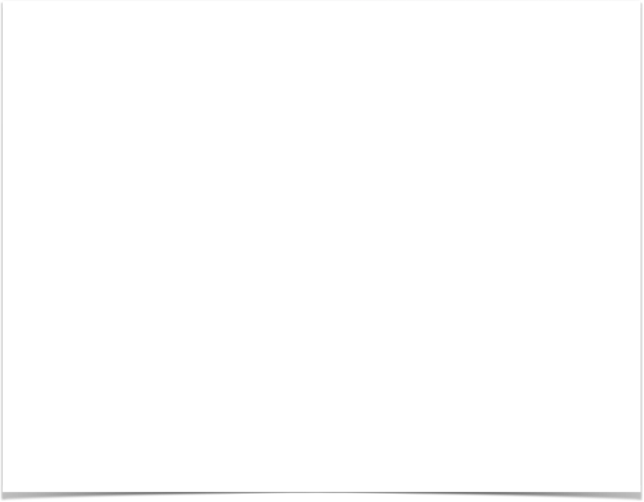
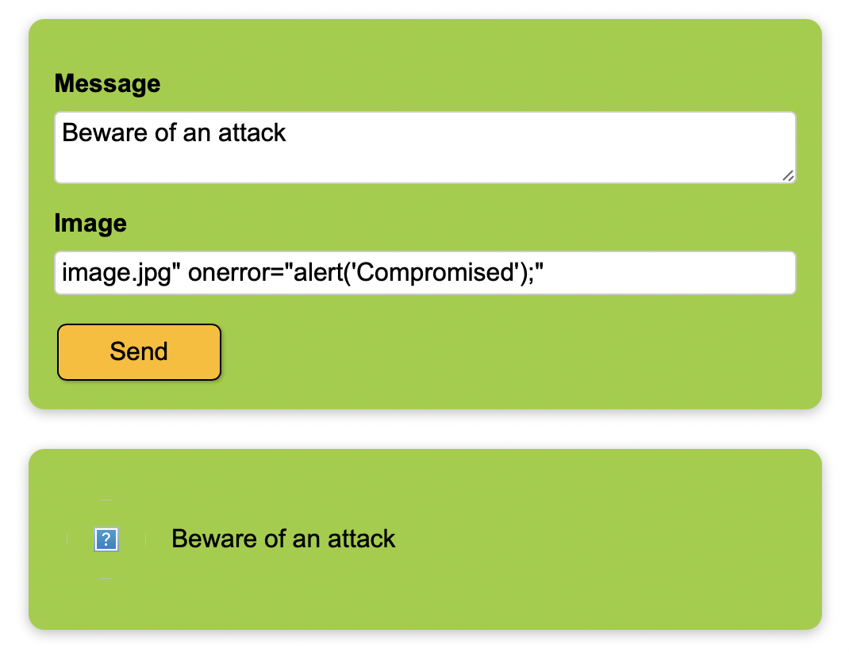

Let’s now check the website behaviour after a filtered user input
Here, as we can see even after a payload input by the user, the XSS is not triggered.
Instead it juts displays the normal input in the comment section.

Slide 21
Conclusion
When auditing metacharacter filters, attempt to determine whether building illegal sequences by constructing embedded illegal patterns is possible. These attacks are possible when developers use a single substitution pattern with regular expressions, such as: $path = s/\.\.\///g;
Hexadecimal encoding is a popular method for evading security softwares used to detect attacks against web servers
HTML decoding is handled by a client browser application. Using this encoding form in XML data does open the possibility of a variety of server-directed attacks

Slide 22
Recap Keywords:
Erroneous Input | Encoding | Stripping | Auditing
Escape characters | Detection | Decoding | Action
Null Byte | Illegal characters | Server-directed attacks | Eliminate
Reject requests | Regular Expressions | Not allowed Error | List allowed filters
Intersection of bad & good | Code Reading | Creativity | Filter Strength

